Slide 1
FINANCIAL AID
How to Apply
What to Expect

Slide 2
FAFSA Free Application for Federal Student Aid
Contact Information
US Dept. of Education web page:
www.ed.gov/studentaid
General Inquiries: 1-800-433-3243
FAFSA web page: http//www.fafsa.gov
My contact information:
Susan S. Waldrum
swaldrum@wcpss.net
Heritage High – Tuesdays 8:30-1:30
Rolesville High – Wednesdays 8:30-1:30
Broughton High – Thursdays 8:30-1:30
To Make An Appointment:
Sign up through Student Services at your school in the appointment book provided. ( Note: at BHS this is located in the Career Development Center.

Slide 3
Important Terms
FAFSA – Free Appliation for Federal Student Aid
EFC – Expected Family Contribution
SAR – Student Aid Report
Award Letter – generated by the college or university detailing the $$$ award you will receive
Grant - $$$ that you do not have to pay back
Scholarship - $$$ given to students who meet certain qualifications based on merit, talent or athletic ability
Work Study - $$$ paid to students for work on campus
Loan - $$$ that you must pay back with interest

Slide 4
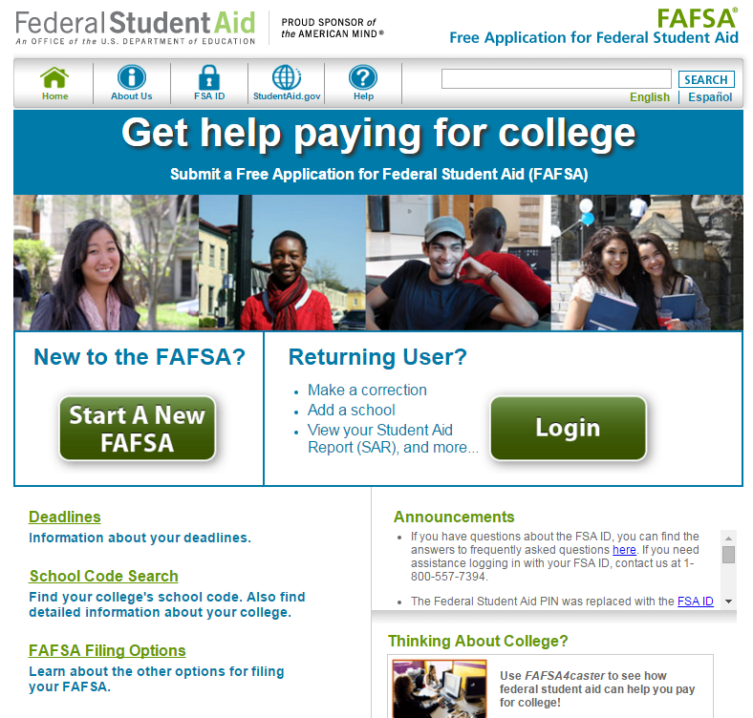
FAFSA on the Web’s Homepage

Slide 5
How to Apply for the FAFSA FAFSA Opens for application on OCT 1, 2016
1. You must apply for a FAFSA ID-for YOURSELF and ONE parent.
2. Go to fafsa.gov
3. Create a User Name and Password for yourself and one parent.
Keep the User Name and Password safe and secure.
4. The User Name and Password will allow you to exit and return to your FAFSA, as well as to electronically sign the document before submitting.
5. You will need your SS#, DOB, Email addresses, & recent tax information.

Slide 6
Other Opportunities
12. Look at various state, local and private scholarship/grant opportunities
Apply for any and all for which you are eligible
Be aware of deadlines for these
13. Make certain that the colleges/universities to which you are applying have all the information for you that they need to process your application and financial aid.

Slide 7
Applying for FAFSA cont’d
6. Fill out the FAFSA online at fafsa.gov
7. You will use the most current year’s 1040 income tax information
8. You will receive a confirmation that your FAFSA has been received
9. Read the entire confirmation page as you will receive information as to your eligibility for grants, loans, etc. – SAR (Student Aid Report)
10. Download a hard copy for your records.
11. You will also receive your EFC (Expected Family Contribution)

Slide 8
The Awarding Process
14. Wait for your AWARD Letter which will detail the types of financial aid that the college/university will extend to you
15. As you receive Award Letters, compare the award amounts and select which of these you want. Just because you are offered an award you have a choice to accept or decline.

Slide 9
The Awarding Process
 | Affordable “U” Usually a Community College | Public University on State Level | Private College or University
Average Cost of Attendance—Tuition, Fees, Room & Board Books/Supplies | $3,000 | $15,000 | $50,000
Grant (Total) | $1,000 | $2,000 | $ 8,000
Scholarship | $ 500 | $7,500 | $25,000
Work Study | $500 | $2,500 | $ 5,000
EFC – The Amount you must pay. | $1,000 | $1,000 | $1,000
Cost of Attendance Additional funds to attend | $1,000 ( -$0- ) | $3,000 ($2,000) | $12,000 ($11,000)
 | Affordable “U” Usually a Community College | Public University on State Level | Private College or University
Average Cost of Attendance—Tuition, Fees, Room & Board Books/Supplies | $3,000 | $15,000 | $50,000
Grant (Total) | $1,000 | $2,000 | $ 8,000
Scholarship | $ 500 | $7,500 | $25,000
Work Study | $ 500 | $2,500 | $ 5,000
EFC – The Amount you must pay. | $1,000 | $1,000 | $1,000
Cost of Attendance | $1,000 | $4,000 | $13,000

Slide 10
Selecting a College or University
Your selection is based generally on these things:
ACADEMIC: Does the institution offer the courses and major you want to prepare you for post college career?
AFFORDABILITY: Can you afford this college/university?
SOCIAL: Does this College/University meet your social, demographic and physical needs?
LOCATION: Do you like the geographic location and climate and accommodations?

